Slide 1


A Provider’s Toolbox:
3. Questioning Skills
THE AWARDING BODY NETWORK

Slide 2
Session Overview
LEARN – LEAD- INSPIRE
- Based on recent research
  i.e., evidence of current situation, and what else is needed
Well done!
  Tweaking performance, recognising your strengths, working on refining skills
What and How?
  Definition and understanding importance of good feedback, and how to do it!
- Questions welcome :-)

Slide 3
Effective Questioning
LEARN – LEAD- INSPIRE
Purpose:
Taking ownership
Encouraging thinking and self-reflection
Engage candidate in their own development and motivation
Logistics:
When and what?
How deep do I go?
Timing
Use of language

Slide 4
Taking Ownership of Learning
LEARN – LEAD- INSPIRE
Problems:
- Competency (‘real’ or perceived)
Expert view
How questions are presented
Antidote:
Constant feedback
No surprises or ‘fake news’
Practice
Make and use resources/notes

Slide 5
Framework for Questioning
LEARN – LEAD- INSPIRE
1. What do you really want?
2. What is stopping you from getting there?
3. What are you going to do about it?

Slide 6
Good Questions
LEARN – LEAD- INSPIRE
* What would you like to have achieved by the end of today?
* What’s missing from your repertoire right now?
* If you could change one thing right now what would it be?
* How will you know when you have completed that action?
* What’s the 1st step you could take?
* What do you not want me to ask you about? ( )
* How does this serve you?
* What are you getting right?
* What was your biggest win today?

Slide 7
Why are they good?
LEARN – LEAD- INSPIRE
AVOID!
Closed (Hmm…)
Personal
Rhetorical
Multiple
Trick
Spiralling
Opinion-based
Vague
Magician!
Subjective
Deep???
Force reflection
Client-centred
Building blocks
Progressive
Challenging
Encourage ownership
Problem solving
Open
Objective
Behaviours and actions

Slide 8
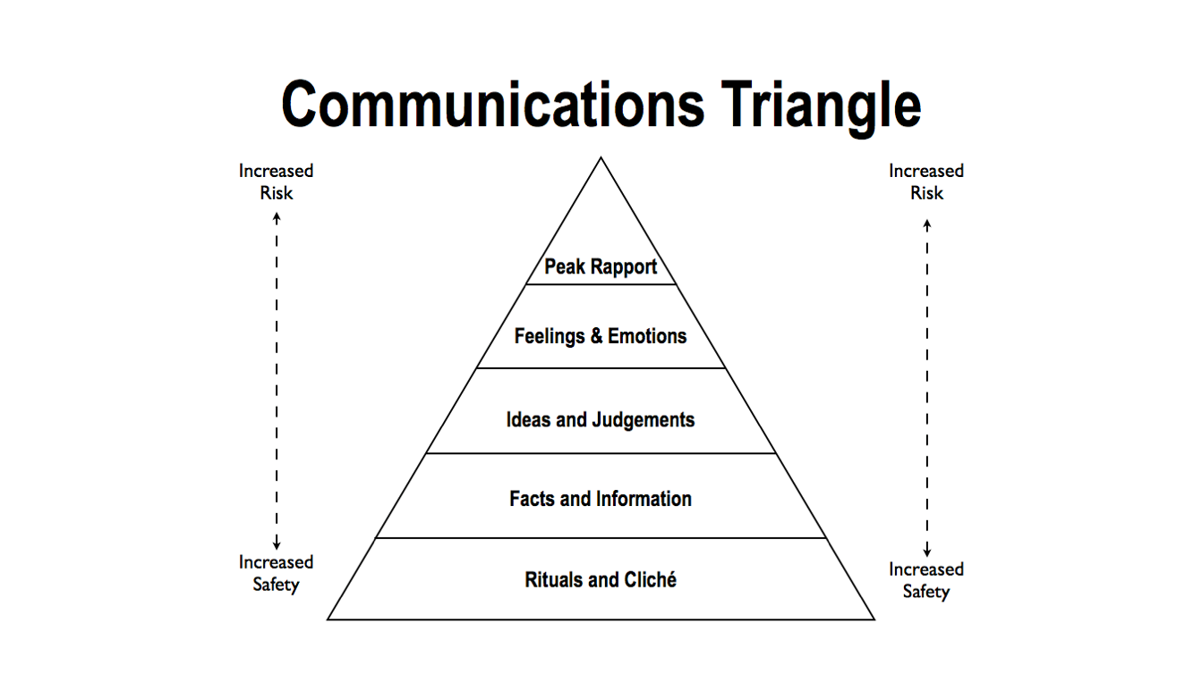
Building Rapport
LEARN – LEAD- INSPIRE

Slide 9

Top Tips
LEARN – LEAD- INSPIRE
Think first!
Silence is golden…And a bit more silence…And even a bit more
But/And
Framework
Purpose above all
If I could ask the greatest question of all time for this person right now, what would it be?
Begin with the end in mind…

Slide 10
Key Points
LEARN – LEAD- INSPIRE
Purpose - Why am I asking this particular question?
What do I want them to respond with?
Is this based on fact and observation, or my opinion?
Homework Questions…
Consider time, place, and mood
Consider (you/them) making notes
Keep it factual, specific and something they can actually work on!
Action Plan and Reviewing

Slide 11
INSPIRE model
LEARN – LEAD- INSPIRE
I - Inspire and motivate your followers with a unified vision
N - Nurture an environment of team-focused goals
S - Set the example you want to see in your followers
P - Praise, and give constructive feedback to help your followers develop
I - Insist on setting high standards, relative to each individual
R - Recognise and respond to each individual’s needs
E - Encourage followers to create and implement their own solutions

Slide 12
One last thing…
LEARN – LEAD- INSPIRE
If in doubt, HEEAR:
- Humble
- Encouraging
- Empathetic
- Appropriate
- Rapport

Slide 13
Questions?
LEARN – LEAD - INSPIRE
samantha_mcelligott@hotmail.com

